Slide 1
ADAPTIVE EMAIL
T RAHUL DHANUSH

Slide 2
DESCRIPTION:
Contextual Adaptation: The system analyzes user data such as past interactions, device usage, time of day, and location to adjust email content in real-time, tailoring the message to suit individual preferences.
Device-Specific Layouts: Whether users are reading on smartphones, tablets, or desktop computers, the email content is optimized for display, ensuring a seamless experience across all platforms.
Personalized Content: Based on user behavior and demographic information, the email’s text, images, and CTAs (calls to action) are dynamically adjusted to align with what the user is most likely to engage with.
Subject Line Optimization: The system uses machine learning to test and adjust subject lines based on individual user preferences and engagement history, increasing open rates.
Time of Day/Behavioral Triggers: Emails are sent at optimal times based on when the user is most likely to interact, improving engagement and conversion rates.
A/B Testing Automation: Adaptive algorithms automatically test different email formats, styles, and content strategies to determine the best approach for different segments of the user base.
Smart Unsubscribe & Engagement Options: The system can learn when users show signs of disengagement and automatically offer customized unsubscribe or preference update options to ensure relevance.

Slide 3
SOURCE CODE:
package com.example.emailapplication
import android.content.Context
import android.content.Intent
import android.os.Bundle
import androidx.activity.ComponentActivity
import androidx.activity.compose.setContent
import androidx.compose.foundation.Image
import androidx.compose.foundation.background
import androidx.compose.foundation.layout.*
import androidx.compose.material.*
import androidx.compose.runtime.Composable
import androidx.compose.ui.Alignment
import androidx.compose.ui.Modifier
import androidx.compose.ui.graphics.Color
import androidx.compose.ui.layout.ContentScale
import androidx.compose.ui.res.painterResource
import androidx.compose.ui.text.font.FontWeight
import androidx.compose.ui.tooling.preview.Preview
import androidx.compose.ui.unit.dp
import androidx.compose.ui.unit.sp
import androidx.core.content.ContextCompat
import androidx.core.content.ContextCompat.startActivity
import com.example.emailapplication.ui.theme.EmailApplicationTheme

Slide 4
class MainActivity : ComponentActivity() {
override fun onCreate(savedInstanceState: Bundle?) {
super.onCreate(savedInstanceState)
setContent {
// A surface container using the 'background' color from the theme
Surface(
modifier = Modifier.fillMaxSize().background(Color.White),
) {
Email(this)
}
}
}
}
@Composable
fun Email(context: Context) {
Text(
text = "Home Screen",
modifier = Modifier.padding(top = 74.dp, start = 100.dp, bottom = 24.dp),
color = Color.Black,
fontWeight = FontWeight.Bold,
fontSize = 32.sp
)

Slide 5
Column(
horizontalAlignment = Alignment.CenterHorizontally,
verticalArrangement = Arrangement.Center
) {
Image(
painterResource(id = R.drawable.home_screen), contentDescription = ""
)
Button(onClick = {
context.startActivity(
Intent(
context,
SendMailActivity::class.java
)
)
},

Slide 6
colors = ButtonDefaults.buttonColors(backgroundColor = Color(0xFFadbef4))
) {
Text(
text = "Send Email",
modifier = Modifier.padding(10.dp),
color = Color.Black,
fontSize = 15.sp
)
}
Spacer(modifier = Modifier.height(20.dp))
Button(onClick = {
context.startActivity(
Intent(
context,
ViewMailActivity::class.java
)
)
},

Slide 7
colors = ButtonDefaults.buttonColors(backgroundColor = Color(0xFFadbef4))
) {
Text(
text = "View Emails",
modifier = Modifier.padding(10.dp),
color = Color.Black,
fontSize = 15.sp
)
}
}
}

Slide 8
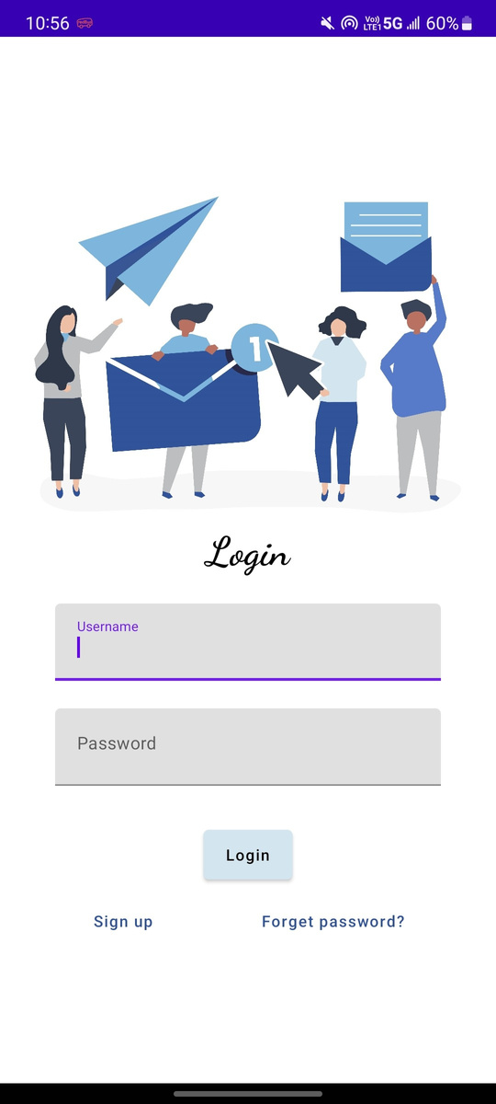
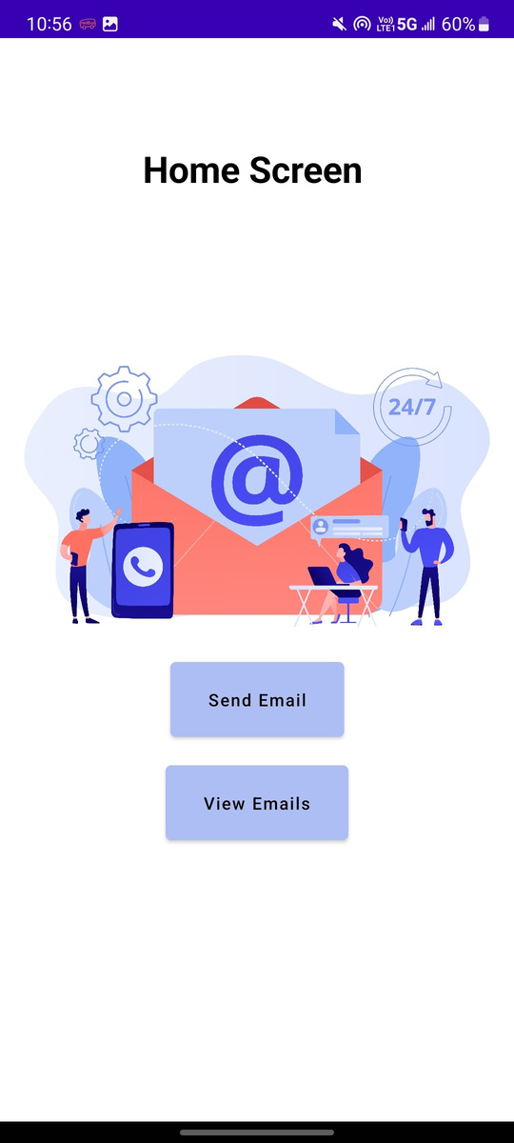
OUTPUT:

Slide 9
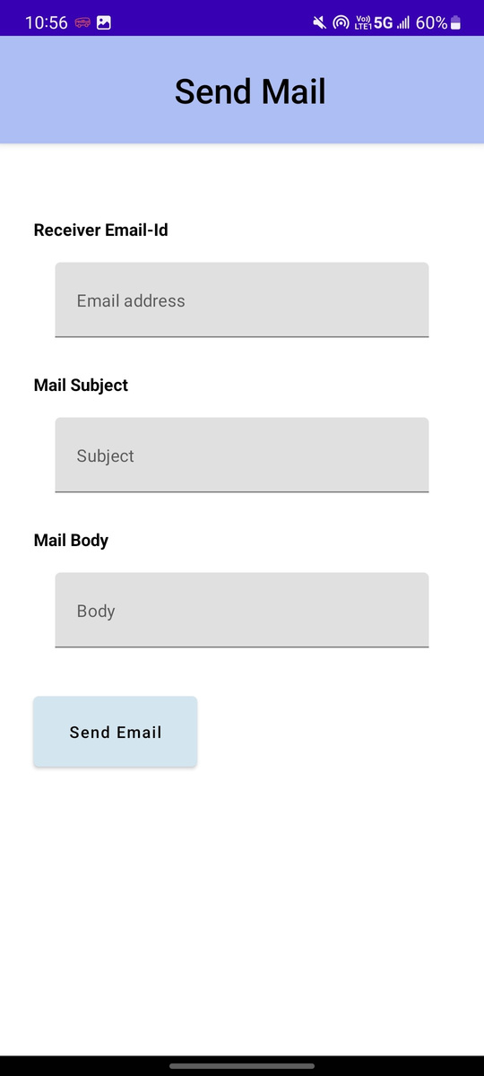
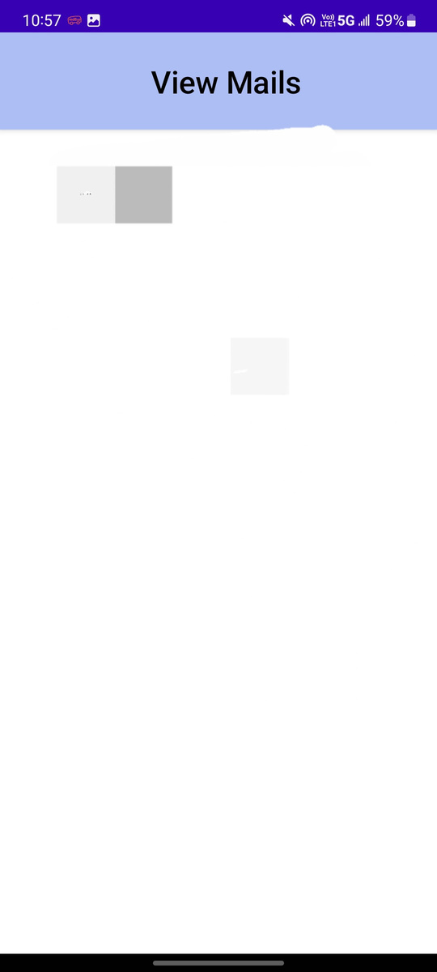

Slide 10
THANKYOU

